Slide 1
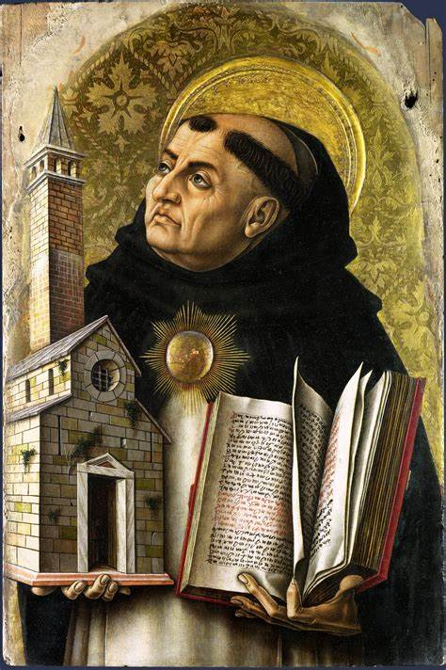
Year 12 Philosophy Holiday Homework
Hello Philosophers!
This pack is designed to introduce you to the Philosophy of religion. In this pack you will be looking at reading and content on:
Arguments for the existence of God
Problem of evil

Slide 2
Year 12 Philosophy Homework
Next year for Philosophy, you will study different arguments for the existence of God. Over this part of the course you will consider different arguments which have attempted to prove the existence of God. The aim of these arguments is to try to prove atheists and theists that God logically (through reason) does truly exist.
The Design Argument
The Ontological Argument
The Cosmological Argument
Reading
The Design Argument
This is an argument for the existence of God.
It points to evidence that suggests our world works well – i.e that it was designed in a specific way. The argument follows that if it was designed like this, then someone or something must have designed it.
There are many examples of how our world is designed in such a way that it works properly. For example:
Trees take in carbon dioxide and give out oxygen.
The Earth is uniquely placed in the solar system so that it can support life - not too close to the sun that we burn up, not too far from the sun that we freeze.
The design argument rejects the idea that we were created by random chance or that we exist because of a Big Bang (the scientific theory that the universe began with a huge explosion about 13.7 billion years ago).
William Paley (1743-1805) compared the design of the universe to finding a watch. He argued that if you were walking on a moor (grassland area) and found a watch lying on the grass and saw how complicated it was you would have to assume someone made it.
By looking at the watch you would see that all the coils, springs and movements all work together so that the watch is able to keep time.
Anyone who found this watch, having never seen a watch before, would have to conclude that someone designed it for it to fulfil its purpose of keeping time.
Paley compared this to the design of the world. He argued that just as someone who found the watch would conclude that it was made by someone because of its design, someone who looks at the universe must conclude that there is a designer because of how the universe has been designed.

Slide 3
Year 12 Holiday Homework
Strengths and weaknesses of the Design Argument
Strengths of the design argument
The argument only comes up with probabilities. Therefore, it can continue to develop as new discoveries in science come along.
The argument fits well with the biblical stories of creation, whether these are understood literally or symbolically.
Some developments of the argument - eg the anthropic principle - provide ways for ideas about evolution and belief in the existence of God to work together.
Weaknesses of the design argument
Complexity does not necessarily mean design.
Even if we accept that the world was designed, it cannot be assumed that its designer is God. And if it were designed by God, then the existence of evil and suffering in the world would suggest the belief that God is entirely good is false.
The theory of evolution, put forward by Charles Darwin, shows a way of understanding how species develop without reference to a designer God.
Task 1 - Research
Using the internet, research any further information on the design argument. You should use the following resources
Stanford encyclopaedia
Panpsycast Philosophy podcast
Task 2 – Note taking
You need to build an understanding of why some people believe that this is a convincing argument to prove the existence of God.
1) Evidence to support the argument
2) Comparison of a watch to the universe
3) Support from Christianity

Slide 4
Task 3 – Reading on the Problem of Evil
Logical Problem of evil:
How is it possible that God is omnipotent?
How is it possible that God is omnibenevolent?
How is it possible that God is omniscient?
If moral and natural evil exist in the universe?
Evidential Problem of evil:
Due to the pointlessness and sheer amount of evil that exists in the universe it is not possible that God exists.
E.g. think of a deer trapped in a burning bush, nobody knows that it is there suffering? It’s death and pain brings nothing to the world? How is it possible that God allows such pointless evil?
Summarise the difference between the logical and evidential problem of evil:
____________________________________________________________________________________________________________________________________________________________________________________________________________________________________________________________________________________________________________________________________________________________________________________________________________________________________________________________________________________________________________________________________________________________________________________________________________________________________________________________________________________________________________________________________________________________________________________________________________________________________________________________________________________________________________________________________________________________________________________________________________________________________________________________________________________________________________________________________________________________________________________________________________________________________________________

Slide 5
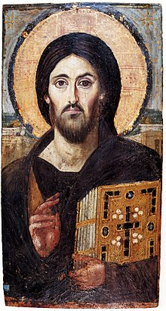
Year 12 Holiday Homework
Responses to the logical and evidential problem of evil:
Soul-making is the theory that evil has to exist so that humans can develop their souls by living and becoming good, moral people. It gives humans a chance to learn from suffering and develop moral virtues.
Augustine’s soul-deciding theodicy
Augustine believed that all humans were created perfect and that they were given free will. However humans use that free will to turn away from God and choose to sin. God foretold that this fall would happen and therefore sent his son, Jesus Christ, so that humanity may be reconciled with God. Augustine’s theodicy bases the origin of evil and suffering on humanity and takes that responsibility away from God.
In his document on faith, hope and love called The Enchiridion, Augustine stated that the definition of evil is the ‘privation of good’ (3:11). This means that evil does not exist in the same way that good exists, but rather that evil is the absence of good. Evil does not have to exist in order for good to exist. There does not need to be an opposite.
This doctrine allows for God to exist as an omnibenevolent being. This is because God is not responsible for creating evil, as evil itself as an entity does not exist.
Irenaeus’ soul-making theodicy
Irenaeus stated that God made humans imperfect and is therefore partly responsible for the existence of evil. To make humans perfect would take away their freedom to live in accordance with God’s will. By creating imperfect humans, individuals are given the chance to develop and grow through a soul-making process into "children of God". Irenaeus stated that eventually good will overcome evil and suffering.
Hick’s vale of soul-making
Hick's theodicy is based on the same one as Irenaeus. However, Hick further developed the theory, called the ‘vale of soul-making.’ Hick agreed that humans were created as imperfect from the start, so that they could grow and develop into the "likeness" of God. He developed this further by explaining that through hardships and life, humans develop virtues, and these virtues are more meaningful than if they were simply graced to humans by God.
These good, moral traits are best as they come from free will. Unlike Augustine, who claimed that humanity destroyed a perfect world, Hick and Irenaeus say that the perfect world is one to look forward to. Hick also believes that everyone has the chance to achieve eternal life.
Develop to become as ‘Jesus’ like as possible to be worthy of heaven

Slide 6
Year 12 Holiday Homework
Task 5– Summarise the different theodicies as responses to the problem of evil and suffering
1) Augustine’s soul deciding theodicy
2) Iranaeus’ soul making theodicy
3) Hick’s vale of soul making
How convincing do you find these theodicies? Why or why not?
________________________________________________________________________________________________________________________________________________________________________________________________________________________________________________________________________________________________________________________________________________________

Slide 7
Year 12 Philosophy Homework
Listen to the following podcast:
‘The Richard Swinburne Interview (Part 1 – Is there a God) Episode 102
The Panpsycast
Make notes on the podcast below
What is the argument of Swinburne?
Why is this argument seen to be convincing?
Which is this argument seen to be unconvincing?

